Slide 1
Alojz Gomola
Obstacle avoidance based on Reach Sets
29th August 2018
Brno
Help to keep your UAS safe

Slide 2
Overview
Problem introduction
DAA in nutshell
Avoidance Framework
Space partition
Data fusion
Avoidance Run
Example: Maze
Example: Storm
Rules of the air
Conflict resolution
UTM concept
Converging Maneuver
Head On Approach
Cooperative Mode
Noncooperative Mode
Overtake Maneuver
Examples

Slide 3
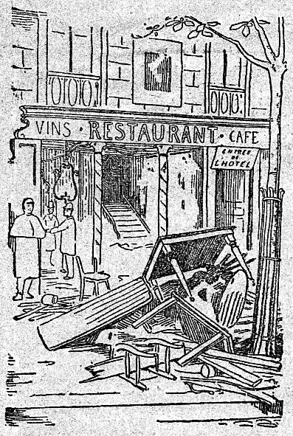
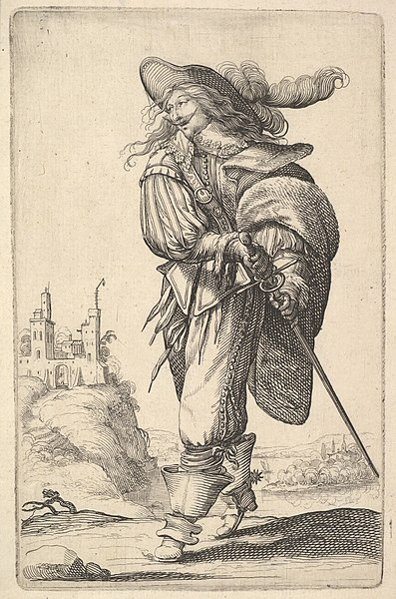
<-
<-
<-
How this gentleman
gets
into the Fine Restaurant
[1]https://commons.wikimedia.org/wiki/File:Le_restaurant_V%C3%A9ry_-_ext.png
[2]https://commons.wikimedia.org/wiki/File:A_gentleman,_walking_towards_the_left_and_drawing_his_sword_from_the_sheath,_wearing_a_plumed_hat_and_boots_with_spurs_MET_DP829192.jpg

Slide 4
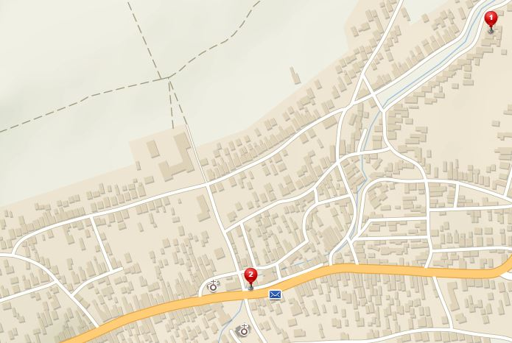
How to get to the fine restaurant ?
Gentleman Home
and
fine Restaurant
Home
Restaurant
Östlichesburg
~ 1269 AD

Slide 5
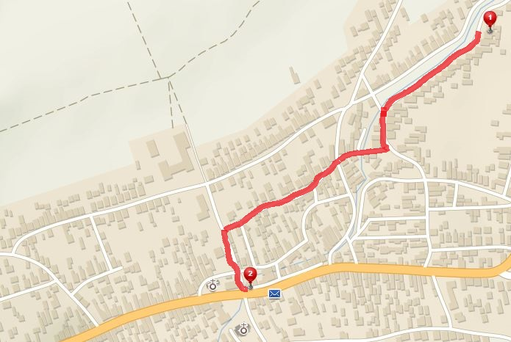
No problem, I know a map of my surroundings
[1] Path planning problem:
1. Get map of surrounding area
2. Find shortest path between waypoints
Use the safe routes [Optional]
Path to restaurant

Slide 6
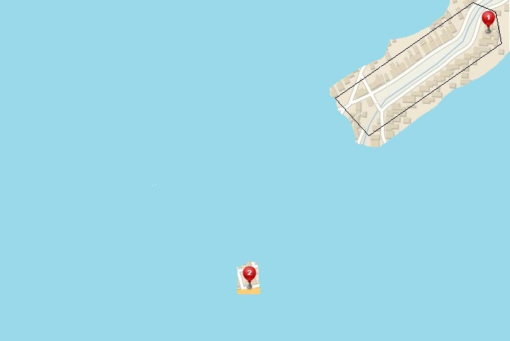
Forget your map, know the restaurant location
You are in front of your Home
You can sense some of your surroundings
(Field of Vision)
[2] Evolving world:
1. You are obtaining more knowledge as you move
2. You need to make Decisions when you reach your FOV boundary
You know where is Restaurant
(Rumors)

Slide 7
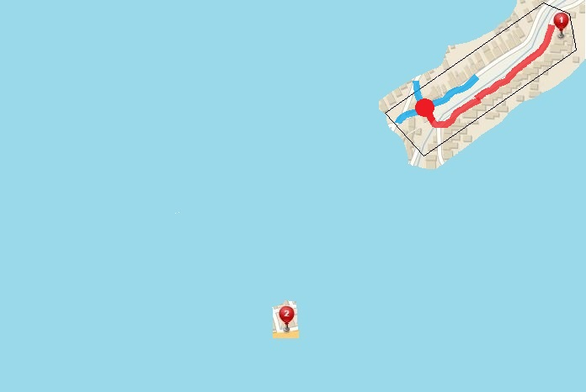
I get to the first intersection, now what ?
Way 3
Way 2
Way 1
Decision point
[2] Evolving world:
Decision Point – point of safe return (I can go home), where I do new sensor scan and decide follow up trajectory
Passed trajectory
You know where is Restaurant
(Rumors)
You will probably apply some sort of COST FUNCTION in your decision

Slide 8
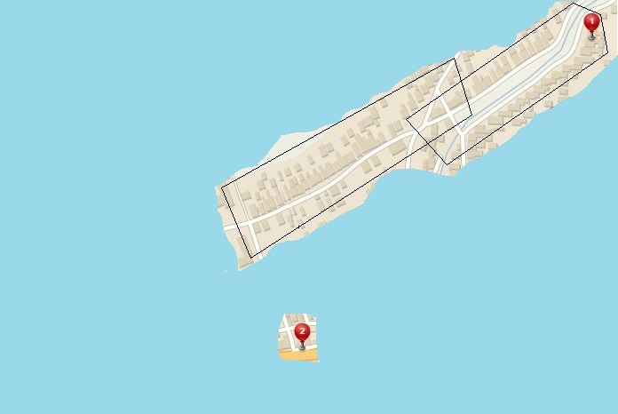
Look around, get know to your surroundings
This patch can get me closer to Restaurant,
(Other sightings NOT so useful)
[2] Evolving world:
Known World – Pieces of observations which are useful for the mission goal
You know where is Restaurant
(Rumors)

Slide 9
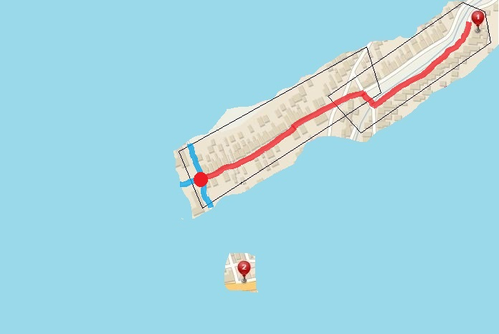
Walk a little more, get closer to the Restaurant
[2] Evolving world:
Rinse and repeat the previous strategy
Way 3
Passed trajectory
Way 2
Decision point
Way 1
You know where is Restaurant
(Rumors)

Slide 10
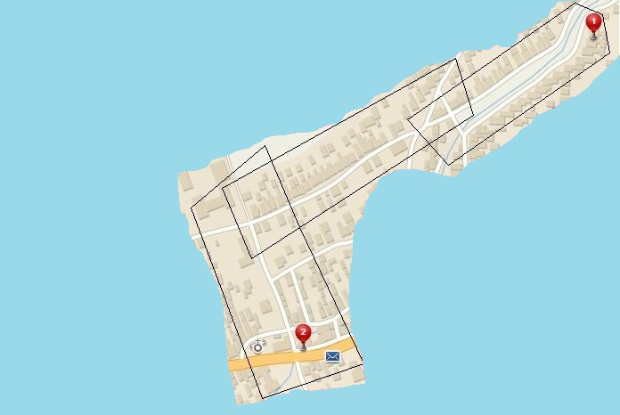
Now Gentleman can see the Restaurant
[2] Evolving world:
Now just walk down to the street and get to the fine Restaurant
You know where is Restaurant
(Rumors)
I can see the way
to the Restaurant

Slide 11
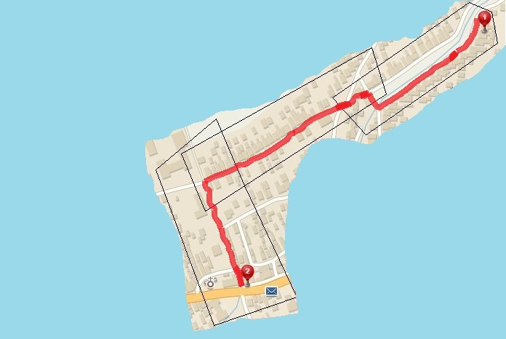
Finally enjoy a Pint with my friends
[2] Evolving world:
Optimal paths in given FOVs
Evolving world cause suboptimal paths
(Note that path [1] is different)
Your destination is at the right side of the road

Slide 12
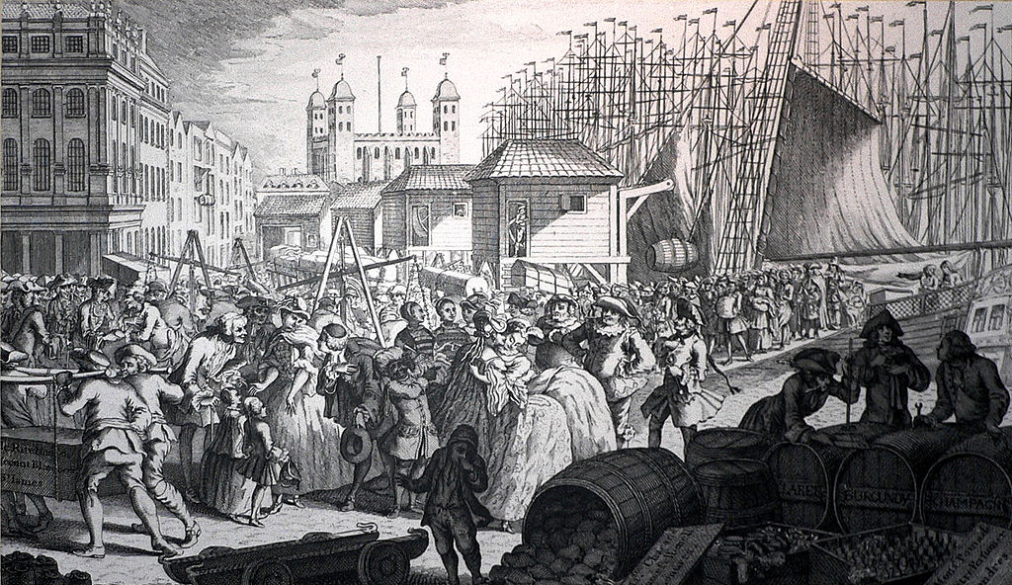

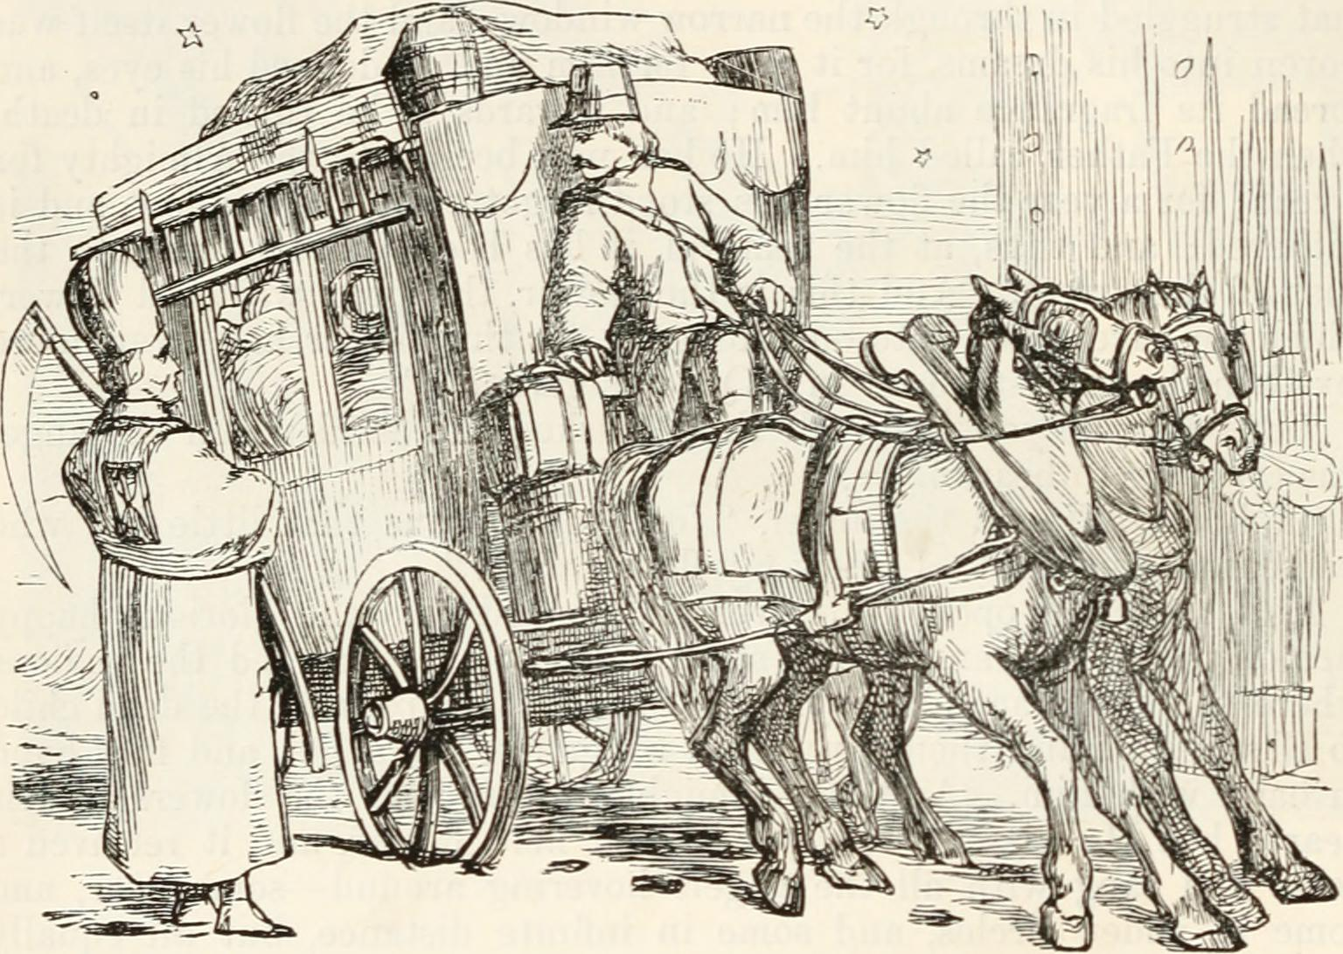
You are NOT alone on the streets !
[3] Adversarial:
While you are moving to Restaurant you need to be cautious about:
Carriages and Other people
Because hitting them can cause damage to you or other people or property
[3] Adversarial:
You need to implement:
Reactive obstacle avoidance
You can assume:
Intruder Position
Intruder Velocity (vector)
Own position and velocity

Slide 13
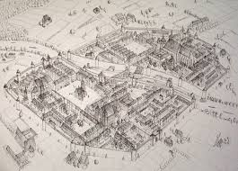
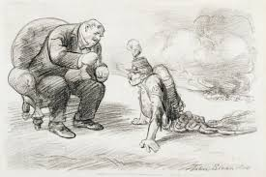
Multiple source of information – Data Fusion
[4] Data fusion:
You are well prepared, you ask locals, you got map, you can see a world, but to make decision you need to process that information:
Data Fusion
Is there to help
[4] Data Fusion:
You need to implement:
Decisions under uncertainty
Determine what is truth
Consider all information
Rank your sources worth

Slide 14
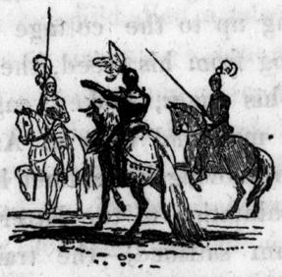
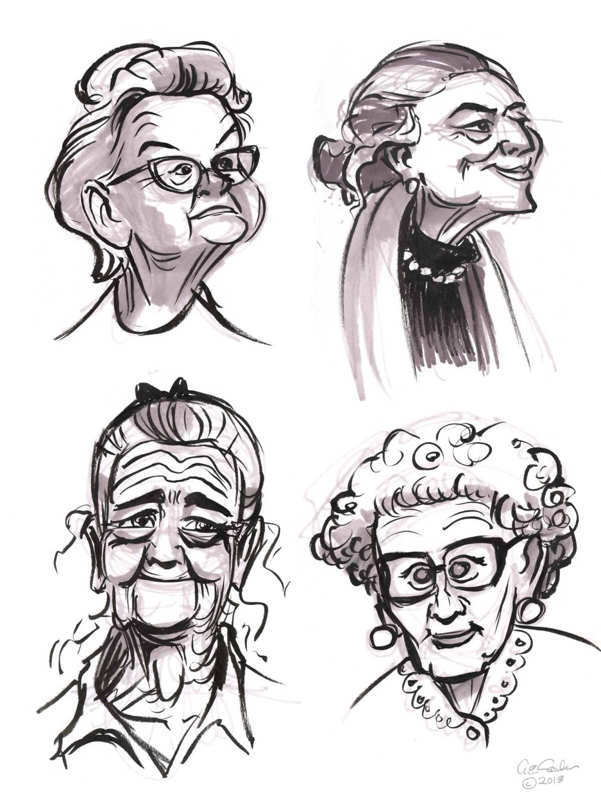
Vigilantes & Grannies – Static restriction areas
[5] Static restrictions:
Well there are inhabited areas which you like to avoid, like Vigilantes whom can beat you or Grannies which will tell your grand mother
[5] Static restrictions:
Breakable – You can tell your grand mother you were on your way to local church
Unbreakable - Gopniks will beat you anyway
Try to avoid all restricted areas

Slide 15
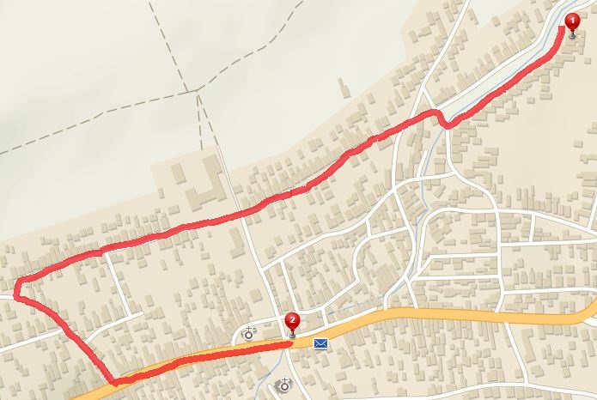
Try to avoid static restrictions areas !
[5] Static restrictions:
Try to avoid them (KW evolution omitted)
Vigilantes – unbreakable, must avoid
Grannies – breakable, but you have no excuse
Vigilante
Grannies

Slide 16


How about weather ?
[6] Weather:
Östlichesburg winter very harsh,
On the other hand,
Östlichesburg summer even Harsher
[6] Weather:
Weather can impact energy consumption
Weather is changing with time
Decision making with additional layer
Impact on your eyes and ears

Slide 17
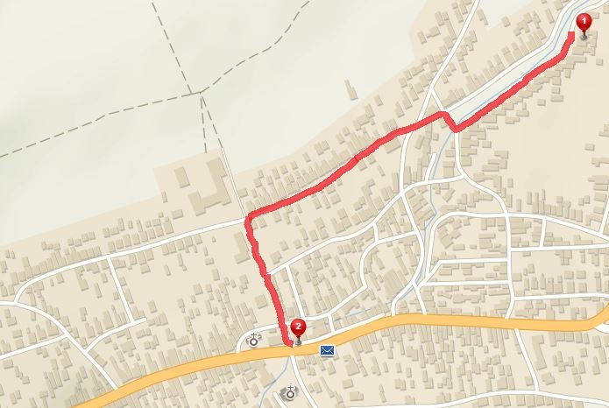
Rather get caught, than catching cold …
[6] Weather:
Try to avoid unfavorable weather conditions:
Heatwave at EAST (changing with time)
Snowstorm at WEST (changing with time)
Snowstorm
I will explain somehow…
Vigilante
Heatwave
Grannies

Slide 18
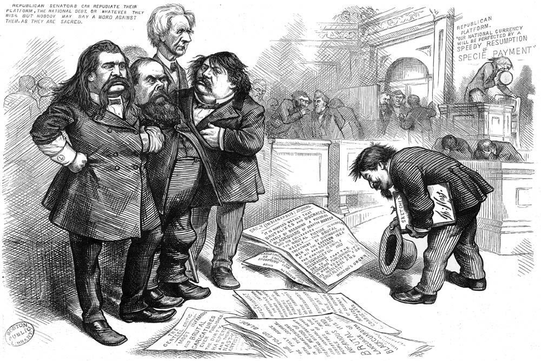
Stick to the rules !
[7] Rules:
Obey rules while walking, keep yourself on right side of the road and look after others …
[7] Rules:
You stick to written and unwritten rules during your commuting
Rules are necessary for succesfull integration into traffic, society, air space

Slide 19
Obstacle avoidance framework
ADS-B
Obstacle Map
LiDAR
Rule Engine
Data fusion
Mission Plan
Avoidance grid
Vehicle control
Movement Automaton
Reach set estimation
Notes:
Rule engine then selects goal of avoidance and Next decision point (There is primitive hard-coded set of rules)
Avoidance grid have been fully implemented and tested for simple plane model in Matlab

Slide 20
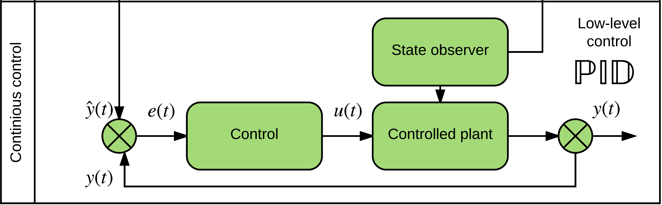
Vehicle control
ADS-B
Obstacle Map
LiDAR
Rule Engine
Data fusion
Mission Plan
Avoidance grid
Vehicle control
Movement Automaton
Reach set estimation
Notes:
Example of Vehicle control can be standard closed loop control
This has been implemented as prototype in Matlab

Slide 21
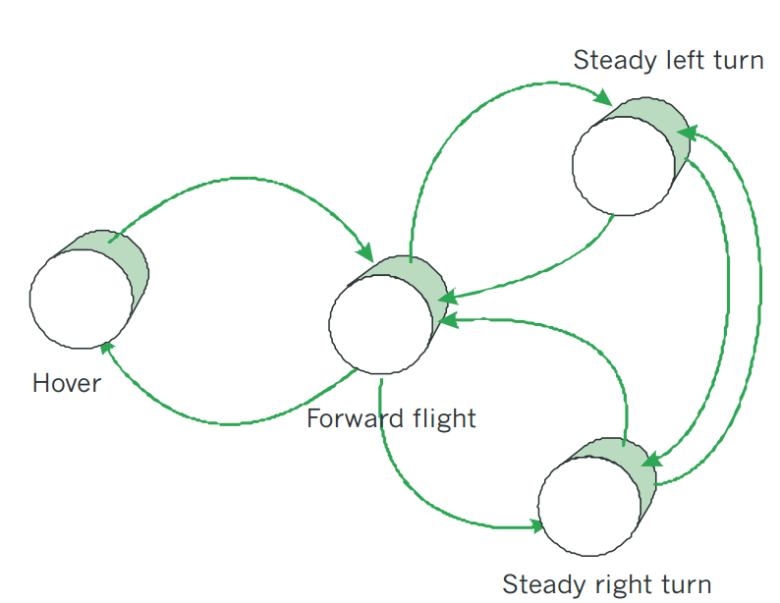
Movement Automaton
ADS-B
Obstacle Map
LiDAR
Rule Engine
Data fusion
Mission Plan
Avoidance grid
Vehicle control
Movement Automaton
Reach set estimation
Notes:
Movement automaton is interface acting between conventional control principles and discrete command chain
eg. Move left 2s, move strainght 2s

Slide 22
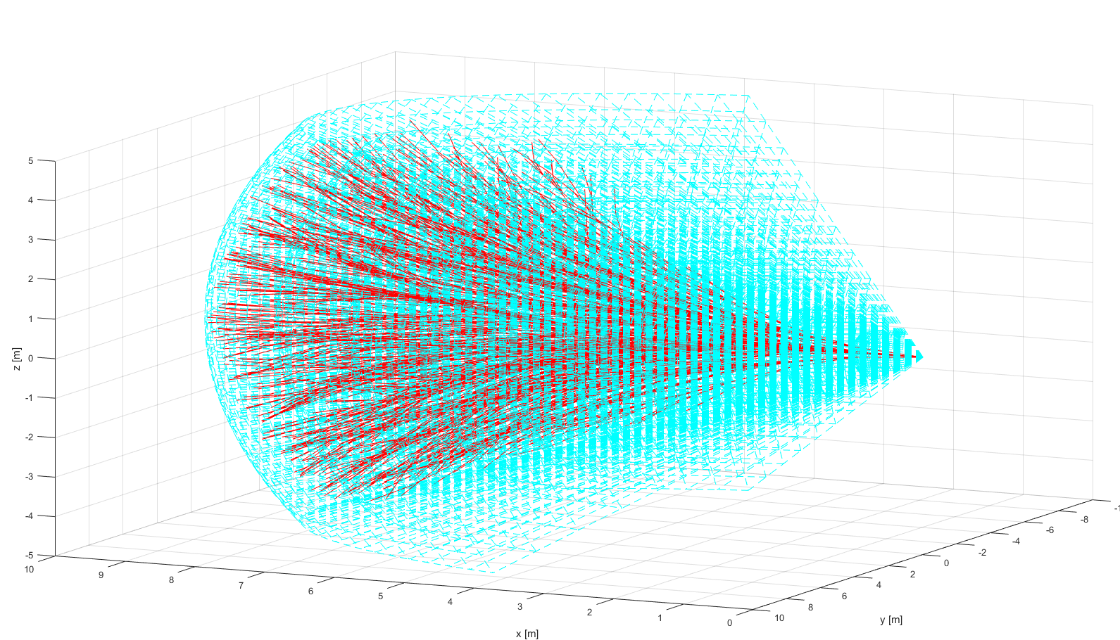
Reach set estimation
ADS-B
Obstacle Map
LiDAR
Rule Engine
Data fusion
Mission Plan
Avoidance grid
Vehicle control
Movement Automaton
Reach set estimation
Notes:
Example of reach set using my method (red) in Field of vision (aquamarine)
There has been implementation of prototype in Matlab (Deterministic version)

Slide 23
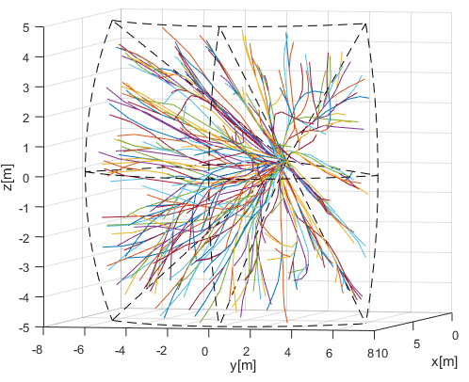
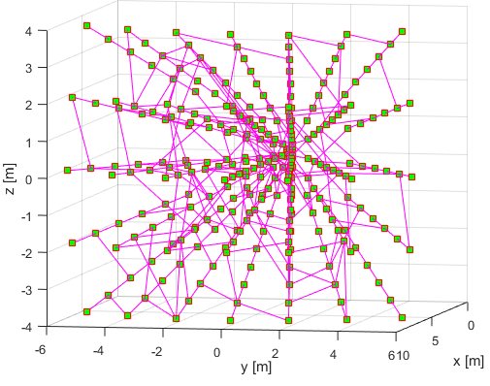
Reach set -Trajectory set & Graph
Trajectory set approximation:
1350 movements
270 paths
Graph approximation:
351 nodes
270 paths

Slide 24
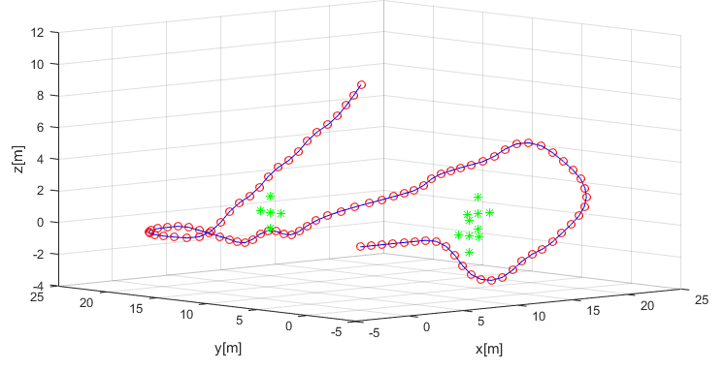
Mission plan
ADS-B
Obstacle Map
LiDAR
Rule Engine
Data fusion
Mission Plan
Avoidance grid
Vehicle control
Movement Automaton
Reach set estimation
Notes:
Example of simple mission with 4 waypoints, implemented as Matlab simulation

Slide 25
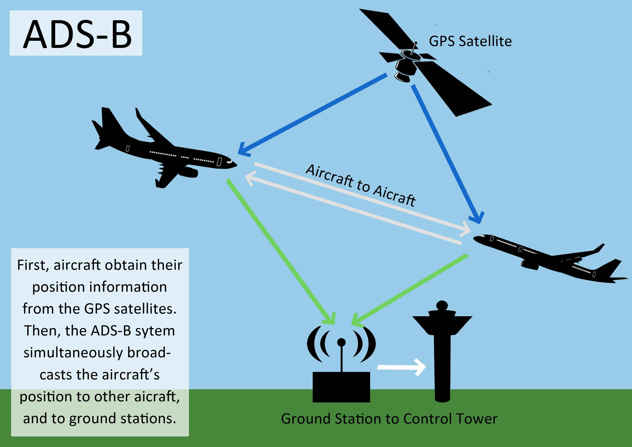
ADS-B
ADS-B
Obstacle Map
LiDAR
ADS-B
Rule Engine
Data fusion
Mission Plan
Avoidance grid
Vehicle control
Movement Automaton
Reach set estimation
Notes:
Here is an example of ADS-B

Slide 26
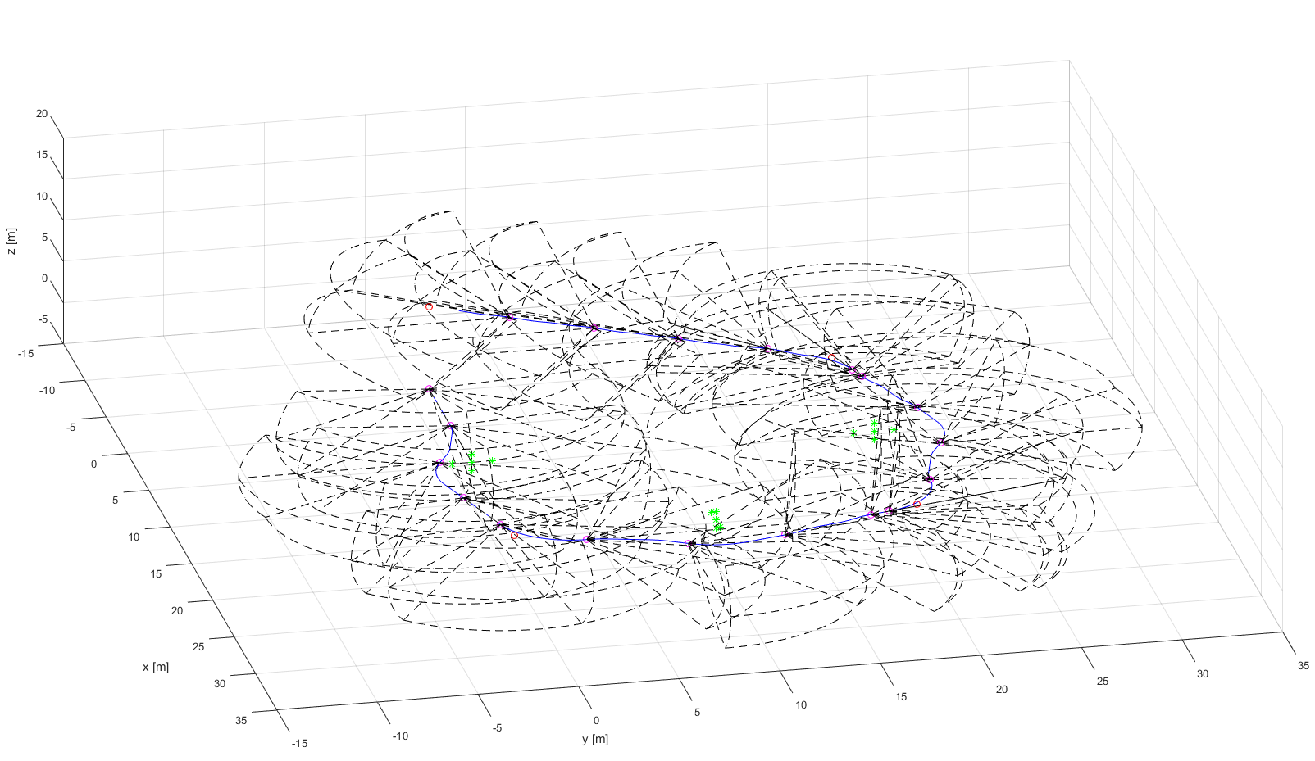
LiDAR
ADS-B
Obstacle Map
LiDAR
Rule Engine
Data fusion
Mission Plan
Avoidance grid
Vehicle control
Movement Automaton
Reach set estimation
Notes:
In the picture you can see example of Flash Lidar scanned area over trajectory

Slide 27
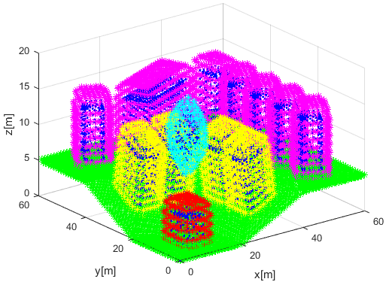
Obstacle Map
Obstacle Map
ADS-B
Obstacle Map
LiDAR
Rule Engine
Data fusion
Mission Plan
Avoidance grid
Vehicle control
Movement Automaton
Reach set estimation
Notes:
Here is example of cuboid coatings (dark blue) with virtual convex coating (magenta, cyan, yellow, red)

Slide 28
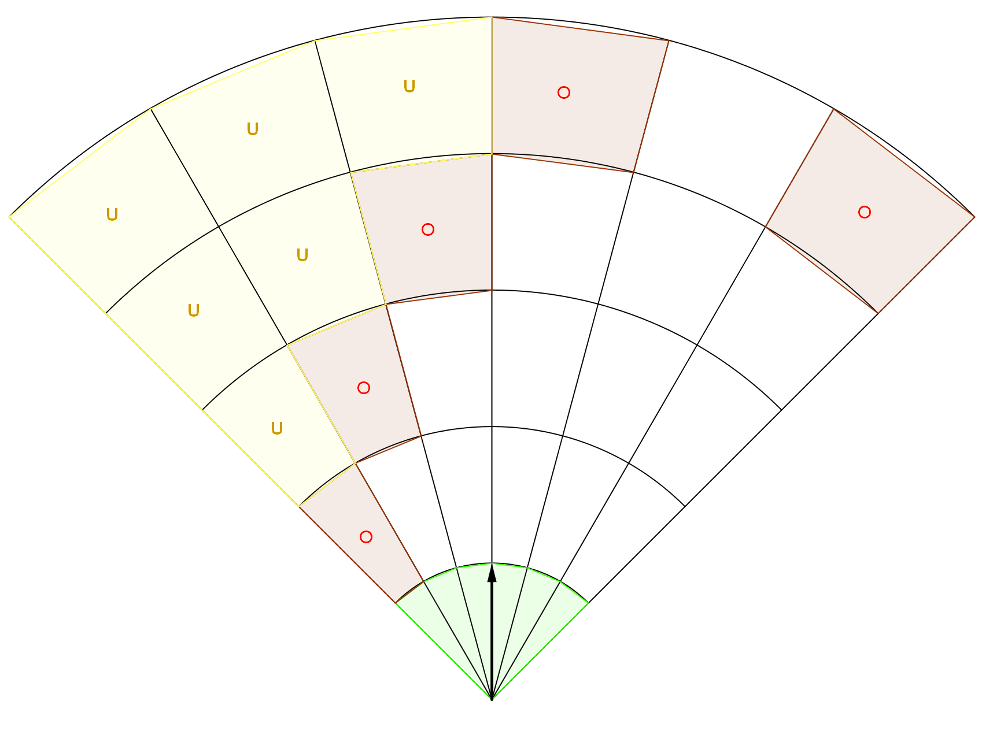
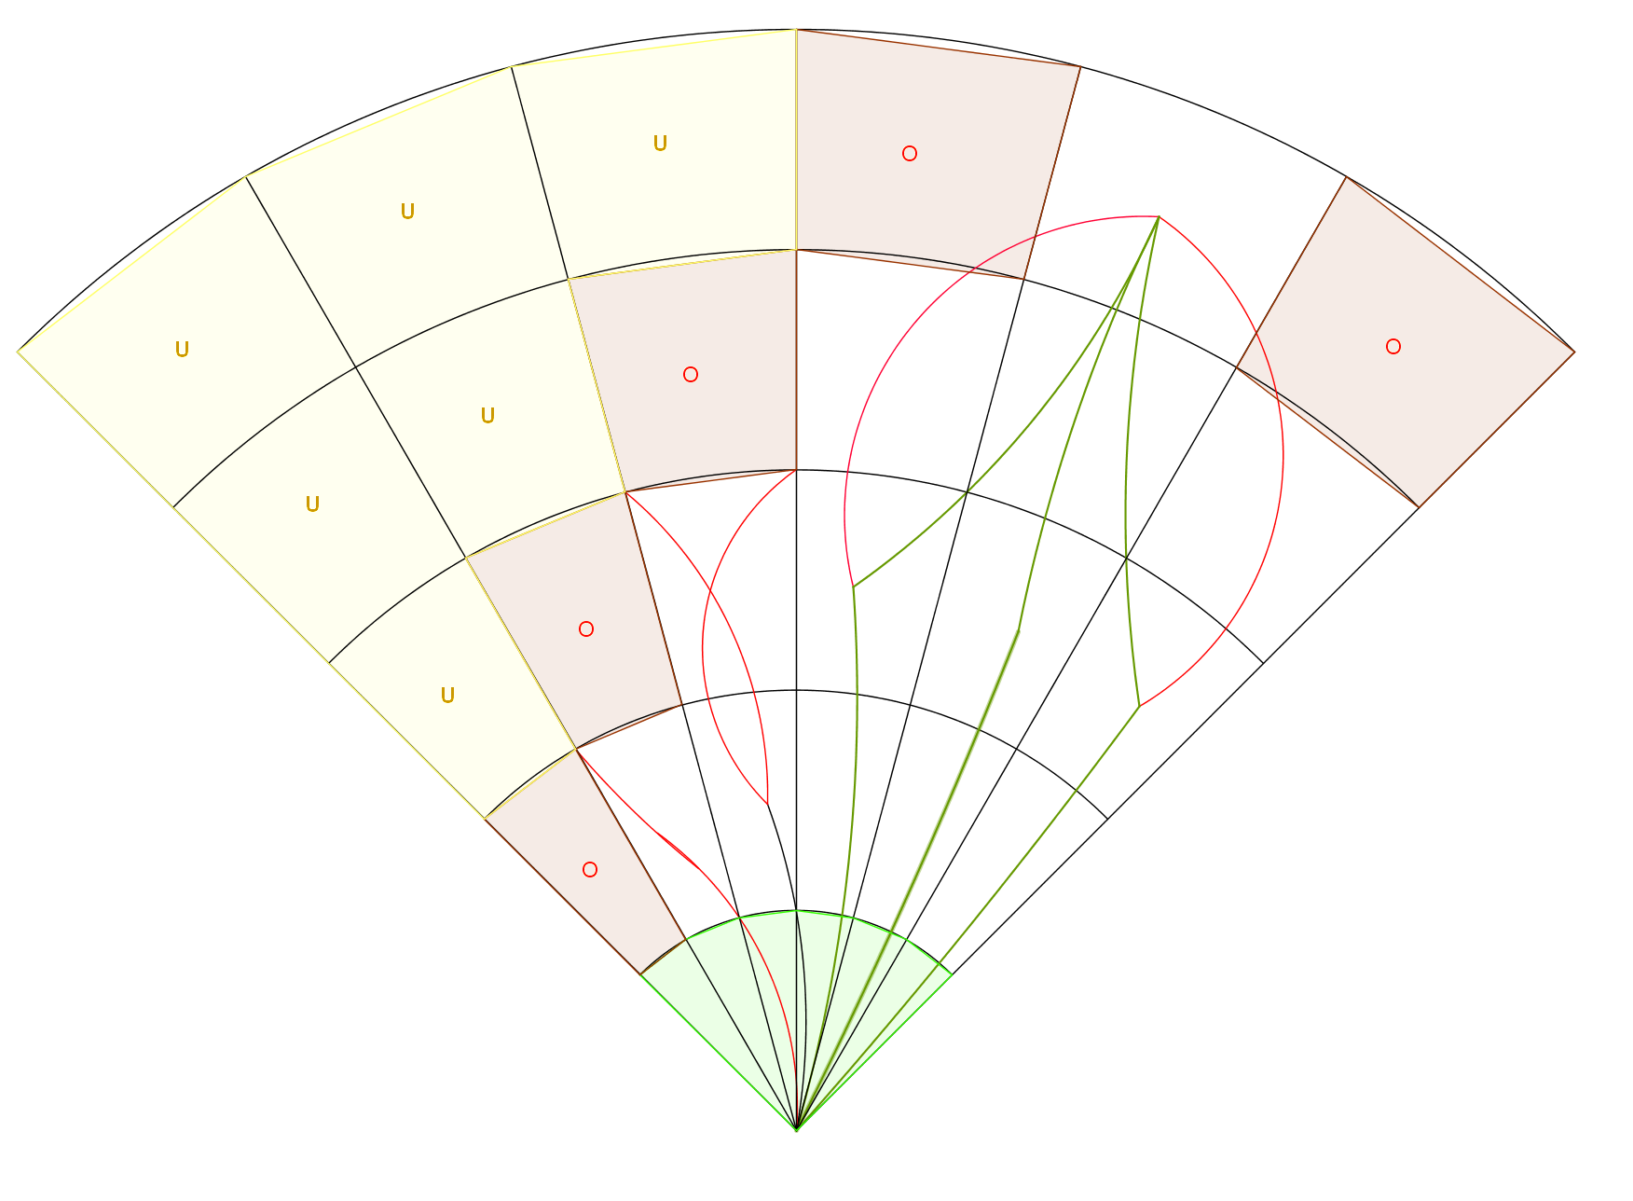
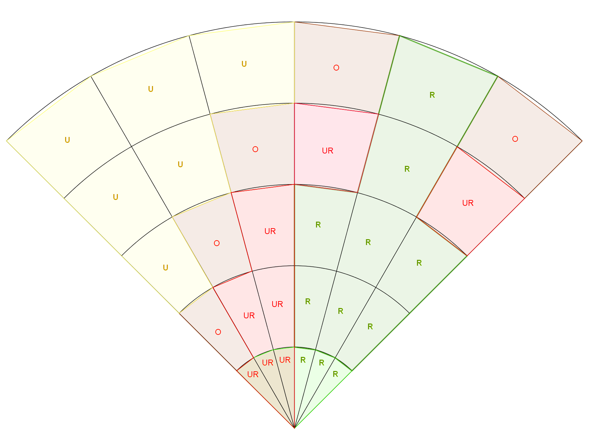
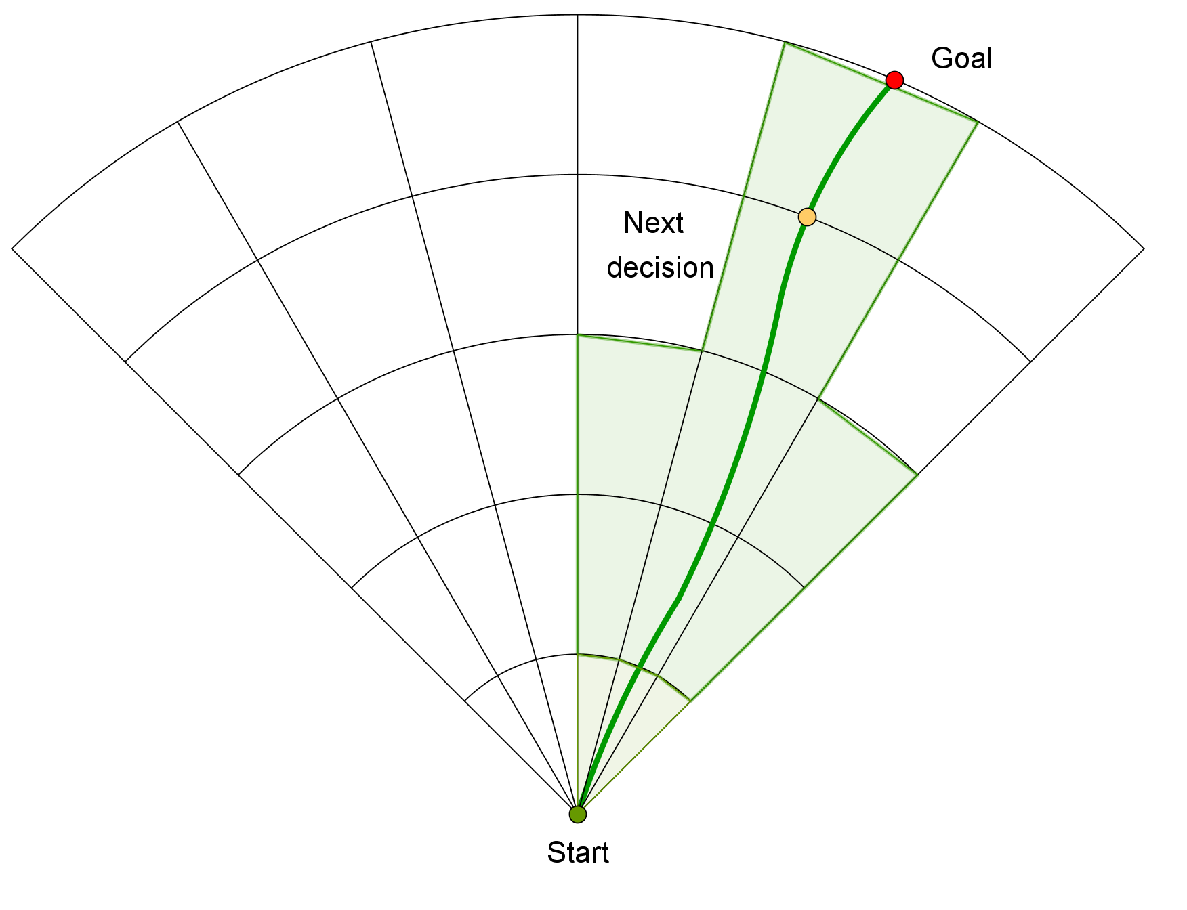
Avoidance Grid
ADS-B
Obstacle Map
LiDAR
Rule Engine
Mission Plan
Data fusion
Avoidance grid
Vehicle control
Movement Automaton
Reach set estimation
Notes:
Reach set is blended and pruned in avoidance grid , giving us estimation of reachable set in constrained space

Slide 29
Obstacle Map
Data fusion
Avoidance grid
Movement Automaton
Notes:
Reach set is blended and pruned in avoidance grid , giving us estimation of reachable set in constrained space

Slide 30
Notes:
Reach set is blended and pruned in avoidance grid , giving us estimation of reachable set in constrained space

Slide 31
Notes:
Rule engine then selects goal of avoidance and Next decision point (There is primitive hard-coded set of rules)
Avoidance grid have been fully implemented and tested for simple plane model in Matlab

Slide 32
Notes:
Rule engine then selects goal of avoidance and Next decision point (There is primitive hard-coded set of rules)
Avoidance grid have been fully implemented and tested for simple plane model in Matlab

Slide 33
Framework Summary
Key notes:
Movement Automaton – interface between control and avoidance grid,
Sensor/Data Fusion – interface between sensors/information sources and avoidance grid,
Reach set – tells UAV where it can go from initial position with given maneuvering capabilities from Movement Automaton,
Avoidance grid – combines known world from Sensor/Data Fusion with Reach set for current vehicle state and applies Rules to find best escape trajectory in Field of Vision,
Rule engine – contains set of Rules,
Solved challenges:
[1] Path planning, [2] Evolving world, [3] Adversarial, [4] Data fusion
You should check this article:
GOMOLA, Alojz, et al. Obstacle Avoidance Framework Based on Reach Sets. In: Iberian Robotics conference. Springer, Cham, 2017. p. 768-779.

Slide 34
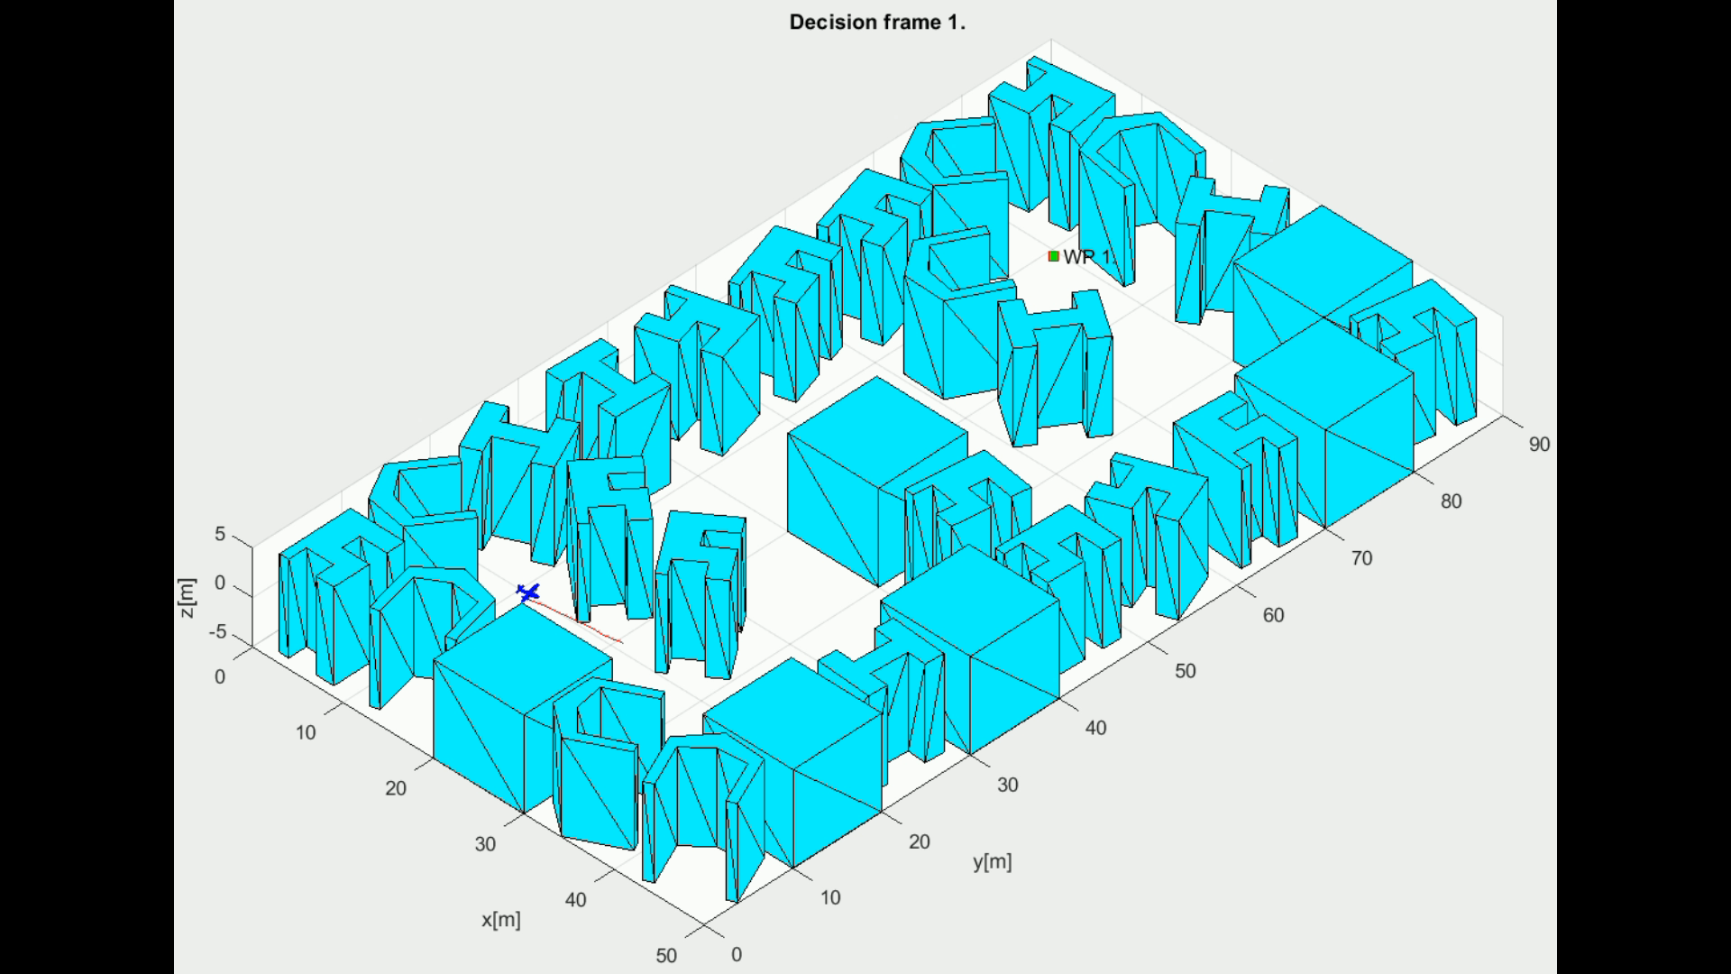
Example: Simple maze

Slide 35
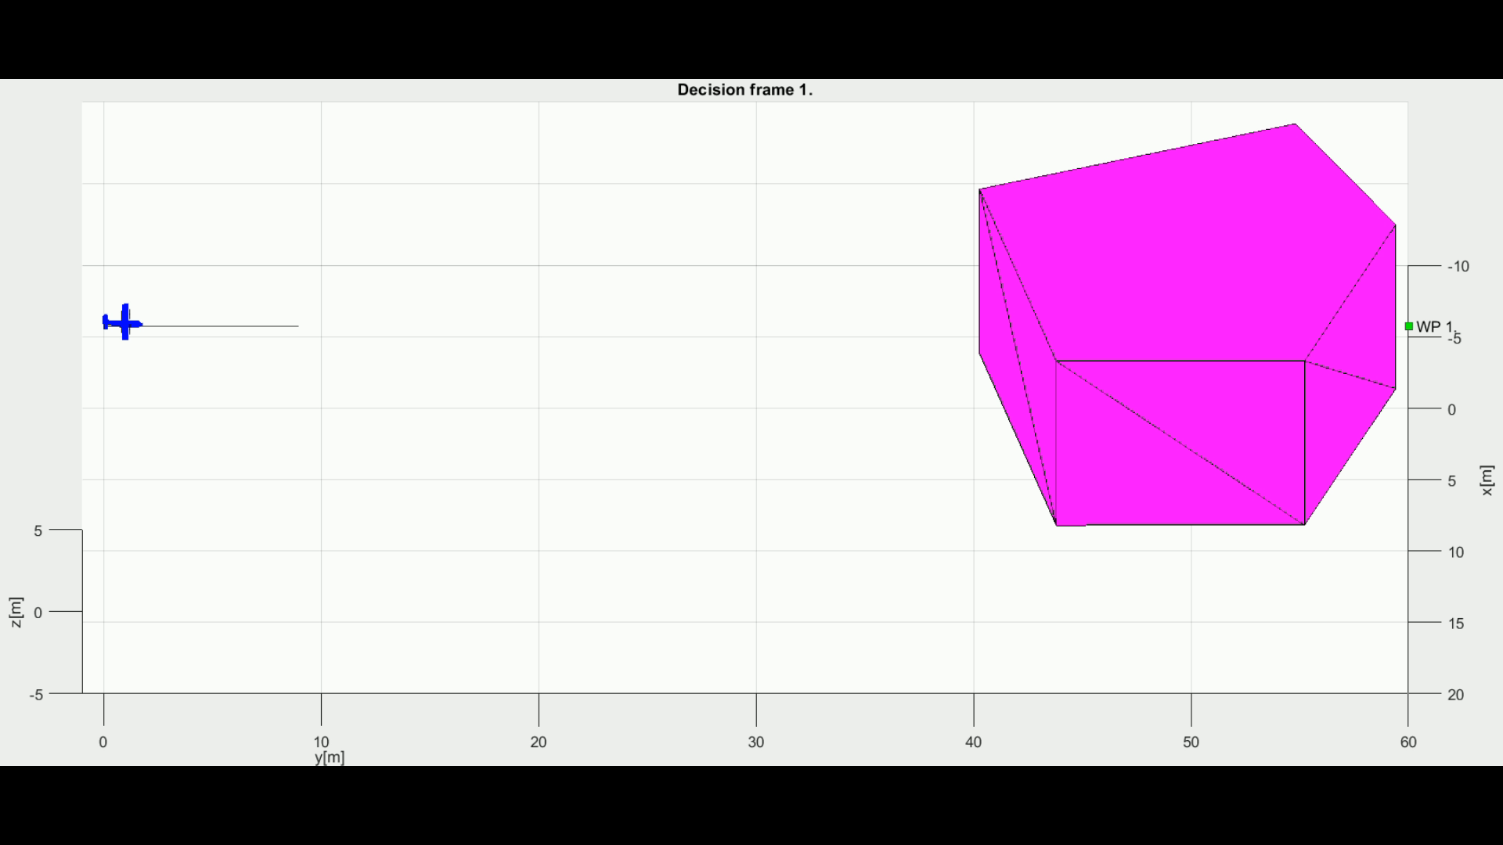
Example: Storm

Slide 36
Rules of the Air Introduction

Slide 37
Conflict resolution
Conflict resolution is Event-based depending on proclaimed aircraft position, heading and velocity, and classification.
Collision Case is created for two conflict participants (2..*):
Position (Latitude, Longitude, Flight level).
Velocity (Vectorizer, Planar),
Vehicle Category (Size/Maneuverability)
Trajectory Prediction (Planned/Predicted)
Collision point (Based on possible trajectory intersection)
Angle of Approach (to adversarial vehicle)
Collision type (Based on Angle of approach)
Avoidance role (Based on previous data)
Collision Case Resolution is given as collision point and enforced speed/safety margin

Slide 38
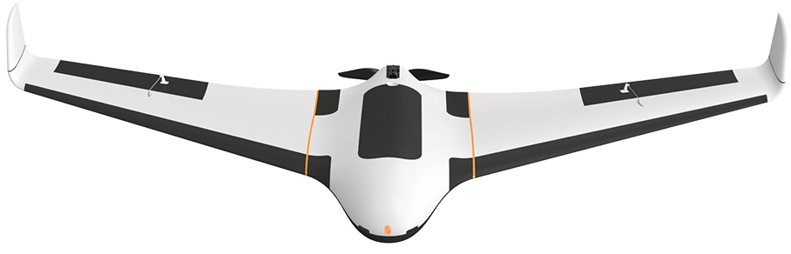
How is Collision Case resolved by UTM
Each vehicle is calculating Collision Cases to nearby vehicles,
UTM is also calculating Collision Cases to cluster vehicles,
UTM issues Resolution advisories or separation rules to prevent collision
Resolution
UAV 1 (S-Rotor)
Mission Control
Navigation Grid
Collision Case
Position notification
UAS Traffic Management
UAV 2 (FACAS)
Position notification
Mission Control
Navigation Grid
Resolution

Slide 39
Right of the Way Rules
Right of the way rules aid pilots in avoiding each other visually
The rules are found:
Part 91 Federal Aviation Regulation (USA)
ICAO Annex 2 -> Chapter 3 - General Rules -> 3.2 Avoidance of collisions -> 3.2.2 Right of way (International)
When aircrafts are converging, the right of way is generally given to the least maneuverable aircraft (higher class).
The aircraft now having the right of the way is to pass well clear of the aircraft not having the right of the way.
Application for rules of the air in case of UAS seems to be reduced to immediate avoidance in case of manned aviation adversary
The avoidance rules can be applied between the same class of UAV.

Slide 40
Rule Engine Architecture
Context
Gather
Context
Rule Engine
Invoke
Engine
Decision point
(Join point)
Mission Control
Rule
Navigation Grid
My mission
Velocity Recalculation
Invoke Rule Instance
Parser
Check condition:
Intruder Velocity
Application
Parse context:
Intruder Position
Take action:
Slow down
Condition

Slide 41
Rule Engine in Nutshell
Benefits:
Modularity – keep rule specific code separated in one class with given condition and impact application, maintain separate functionality .
Scalability – use piece wise code in navigation/avoidance/control frameworks, activate/deactivate aspects and specific behaviors.
Rule chaining – rule can be invoked from Decision (Join) Point, or from other rule body, for example specific maneuver rule can be invoked from resolution rule, this becomes especially handy when aspects of logical programing are necessary.
Shortcomings:
Border Case Testing – needs to be implemented to verify rule functionality as intended, the test conditions are hard to assume.
Configuration Bias – is induced at change of configuration.

Slide 42
Rule Engine Setup
0..*
0..*
0..*
Context
Decision Point
Rule
Mission Control
Before Avoidance Run
Detect Collision Cases
After Avoidance Run
Close Collision Cases
Navigation Grid
Trajectory Restriction
Resolve Collision Cases
Invoke based on:
Avoidance role
Converging Maneuver
Overtake
Head On Approach
Right Plane Heading
Forced invoke:
Enforce Safety Margin

Slide 43
Converging Maneuver
Situation:
Two UAS systems equipped with ADS-B are approaching Collision Point
Both are using Horizontal Separation
Angle of Approach is equal to 90 degrees
Resolution (Emergency)
Both UAS receive ADS-B message with intruder velocity and position
Safety margin: 1.2 m (30 cm body radius, 30 cm protection margin)
Intruder model: Time-Based, Body mass intersection (r=60 cm)
Resolution (Rule Based)
Both UAS broadcasts position notification message to UTM system
UTM creates Collision Case and Mandates UAS with Avoidance Roles
Safety margin: 8 m (Enforced in Navigation Grid)

Slide 44

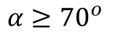
Converging Maneuver - Trigger
$$α≥{70}^{o}$$

Slide 45
Converging Maneuver - Resolution
Turn right and stay away from approaching aircraft

Slide 46
Converging Maneuver – Leave condition
Return to original path behind other aircraft

Slide 47
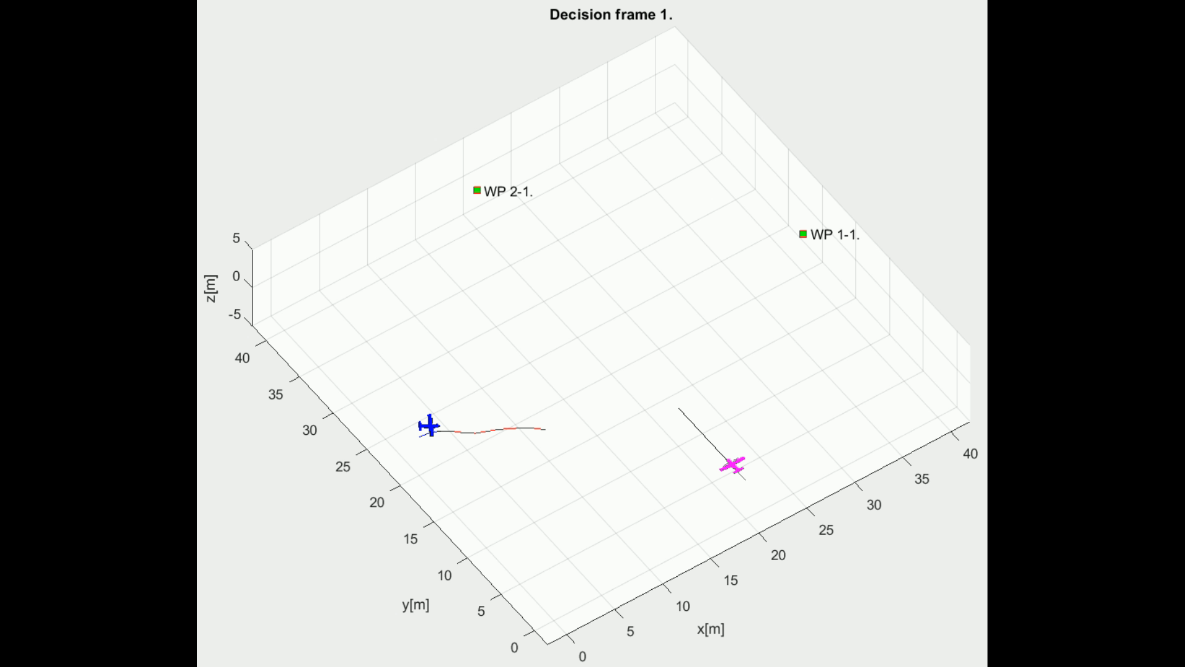
Example: Converging Manuever

Slide 48
Head On Approach
Situation:
Two UAS systems equipped with ADS-B are approaching Collision Point
Both systems are using Horizontal Separation
Angle of Approach is equal to 180 degrees
Resolution (Emergency)
Both UAS receive ADS-B message with intruder heading and position
Safety margin: 1.2 m (30 cm body radius, 30 cm protection margin)
Intruder model: Time-Based, Body mass intersection (r=60 cm)
Resolution (Rule Based)
Both UAS broadcasts ADS-B message to UTM system
UTM creates Collision Case and Mandates UAS with avoidance roles
Mutual distance (Safety) margin: 10 m (Enforced in navigation grids)

Slide 49
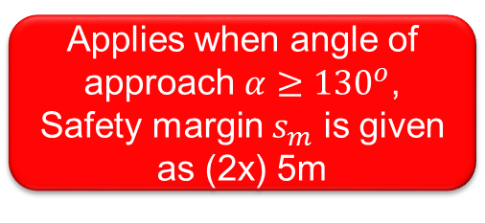
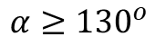
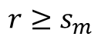
Head On Approach - Trigger
$$α≥{130}^{o}$$
$$r≥s_{m}$$
Applies when angle of approach $α≥{130}^{o}$, Safety margin $s_{m}$ is given as (2x) 5m

Slide 50
Head On Approach - Resolution
$$r≥s_{m}$$
Both vehicles are taking right side avoidance

Slide 51
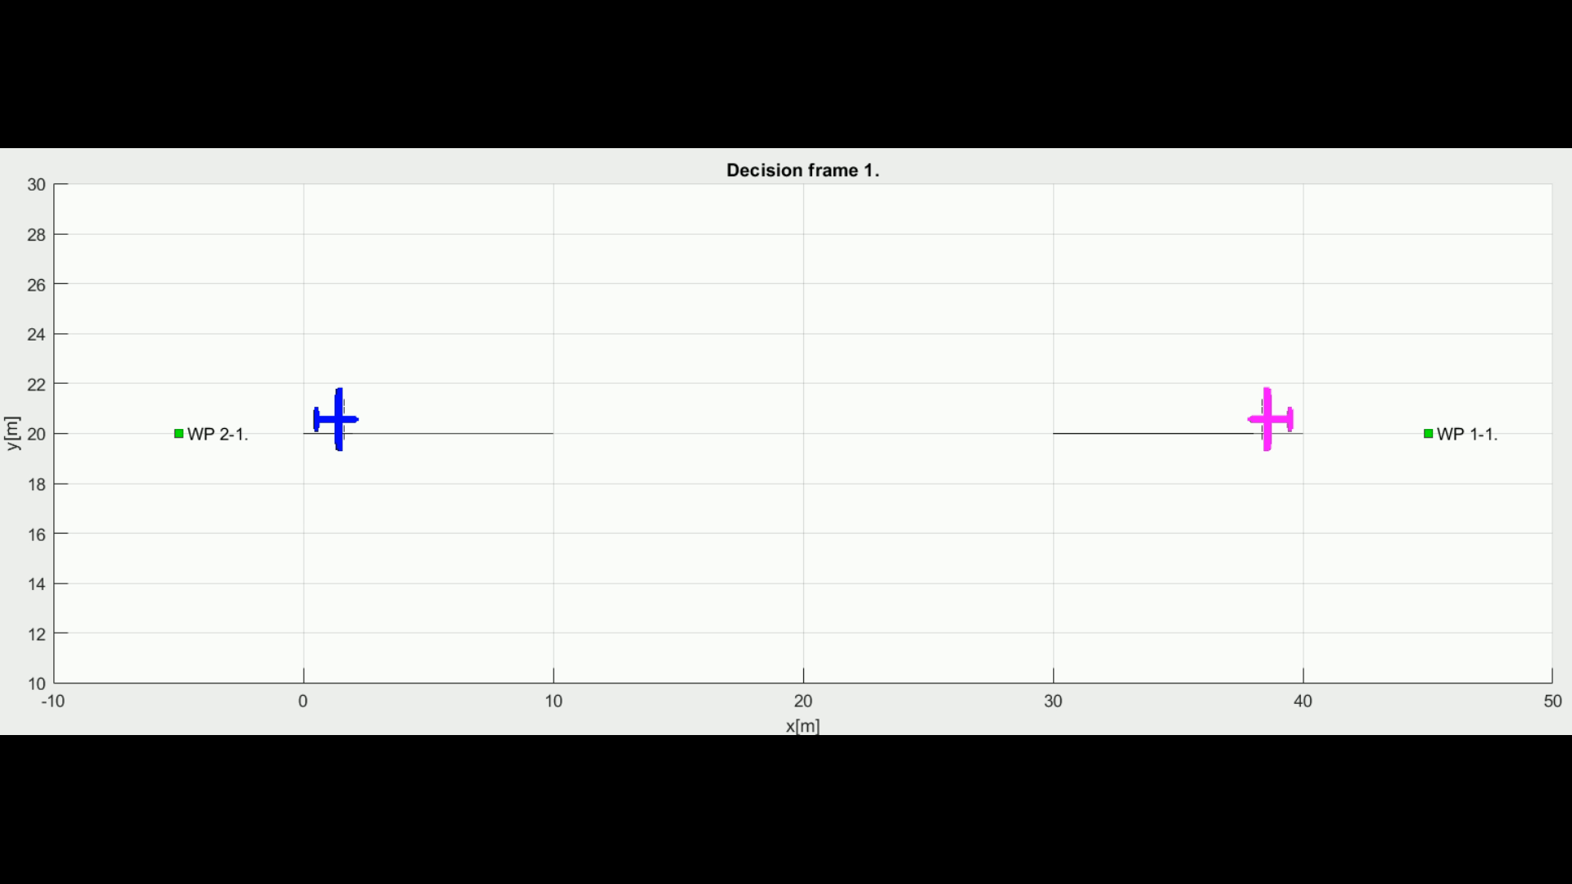
Example: Head On Approach

Slide 52
Cooperative separation scenario
Position Notification
Position Notification
UAS 1
2
UAS 3
1
Calculate collision Cases
Create Virtual
Roundabout
Directive
Directive
UAS Traffic Management
Directive
Directive
Send
Directives
Enforce
Directives
3
4
UAS 2
UAS 4
Position Notification
Position Notification

Slide 53
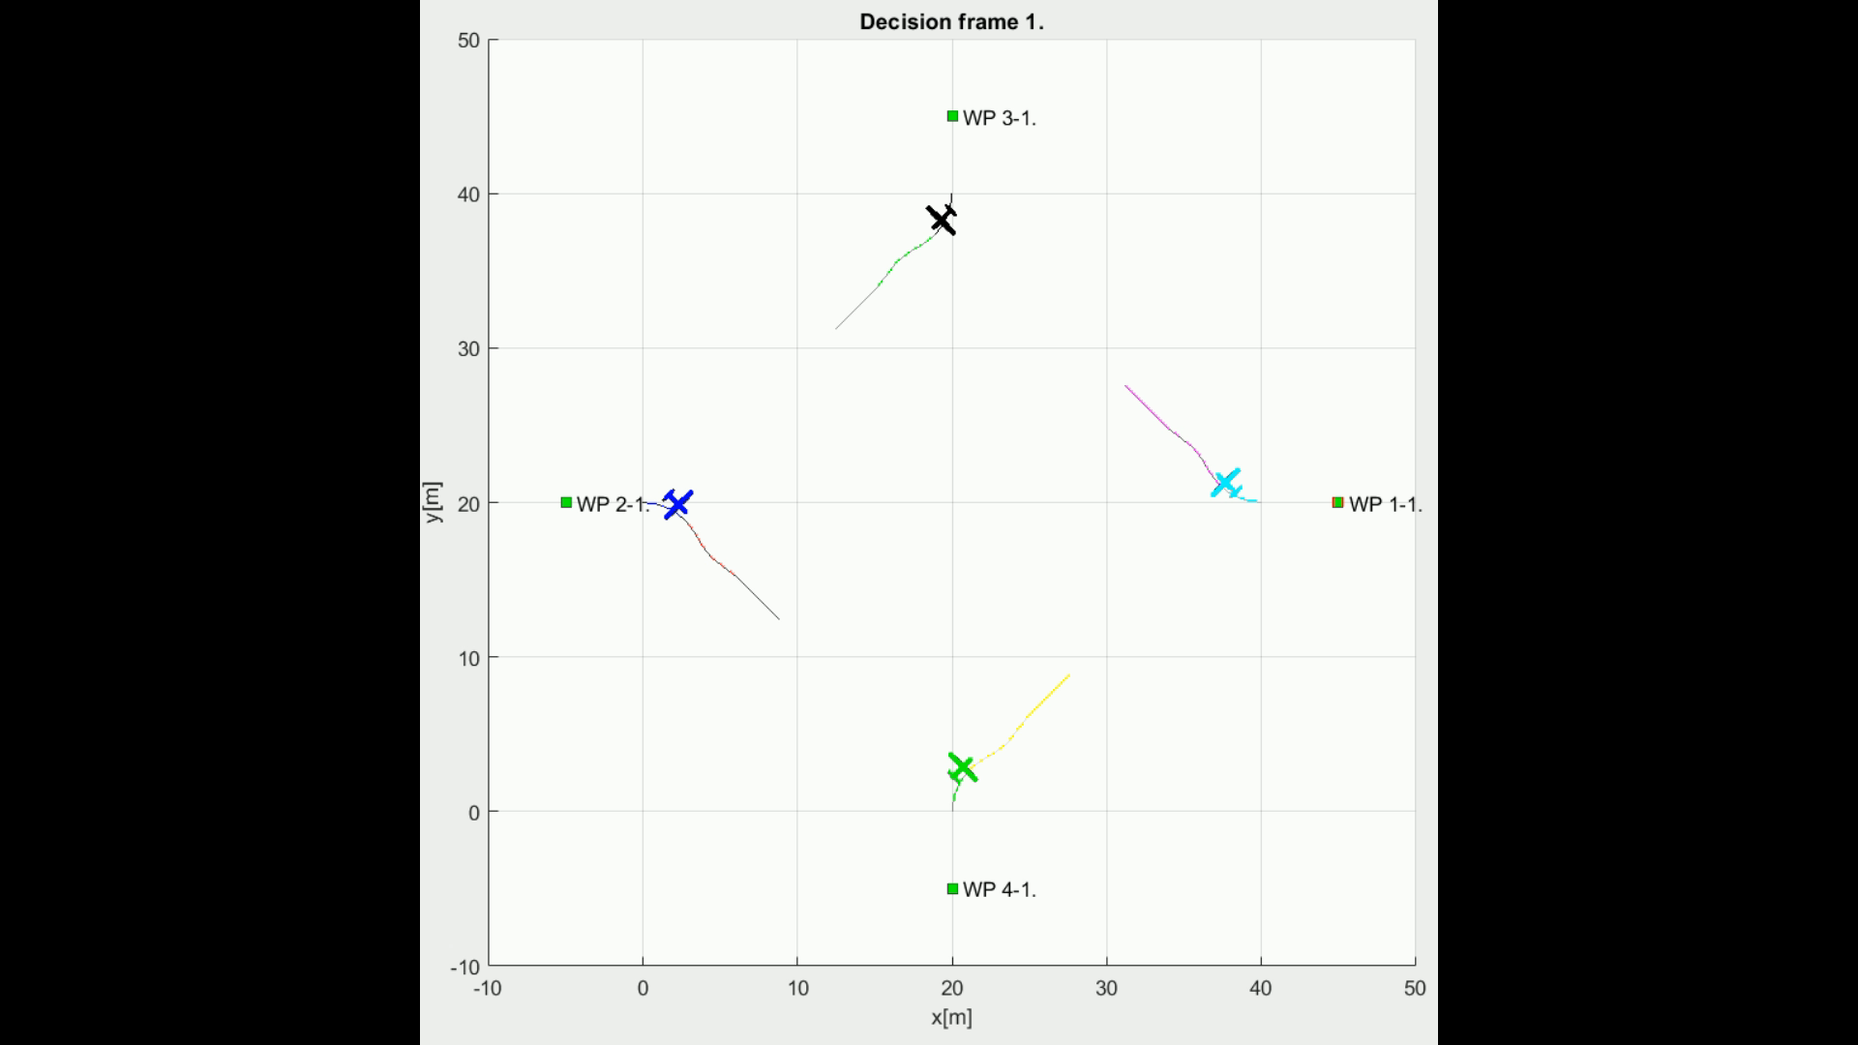
Example: Cooperative separation scenario

Slide 54
Non-cooperative separation scenario
Alert
UAS 1
UAS 3
Alert
Response
Consensus
UAS 1: Horizontal Separation
UAS 2: Vertical Separation
UAS 3: Horizontal Separation
UAS 4: Vertical Separation
Response
Alert
UAS 2
Response
UAS 4

Slide 55
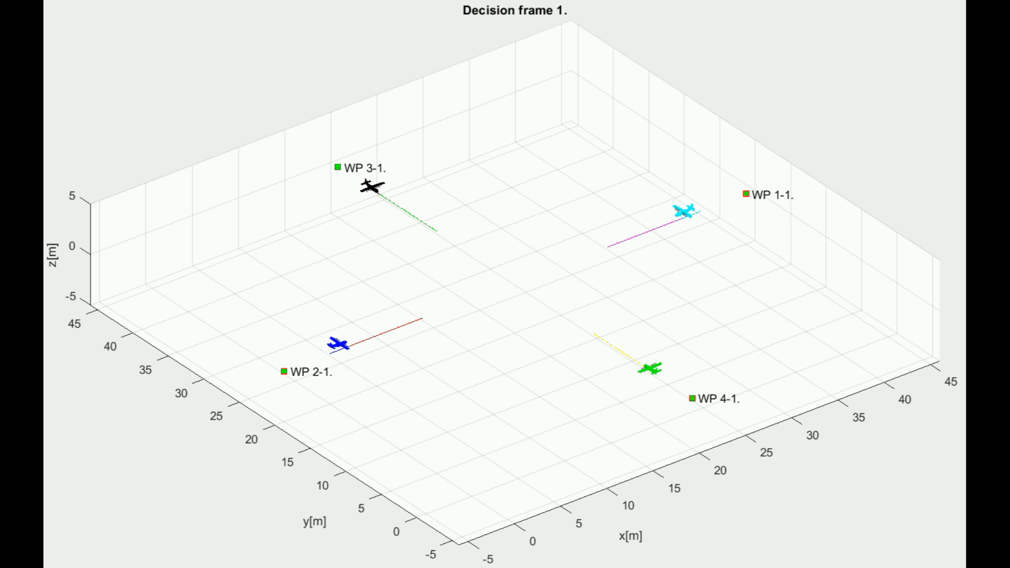
Example: Non-cooperative separation scenario

Slide 56
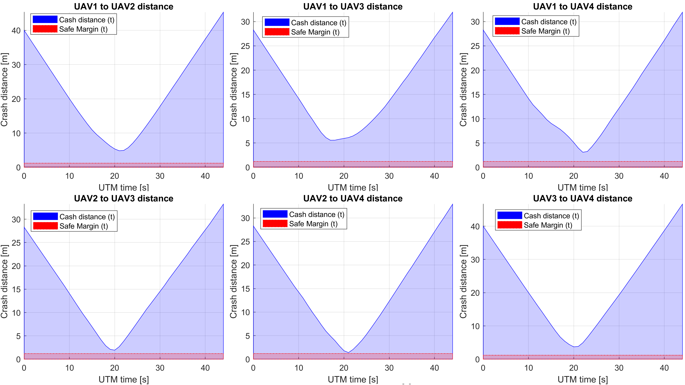
Performance: Non-cooperative separation scenario

Slide 57
Overtake Maneuver
Situation:
Two UAS equipped with ADS-B are flying in same direction
Both systems are using Horizontal Separation
Angle of Approach is equal to 0 degrees
Overtaken UAS is slower than Overtaking UAS
Resolution (Rule Based)
All UAS broadcasts ADS-B message to UTM system
UTM creates Collision Case and Mandates UAS with Avoidance Roles
Safety margin: 5 m (Enforced in Navigation Grid)
Simulation Scenarios:
Speed of Overtaking UAS is 2x higher than speed of Overtaken UAS
Speed of Overtaking UAS is 3x higher than speed of Overtaken UAS
Speed of Overtaking UAS is 4x higher than speed of Overtaken UAS

Slide 58
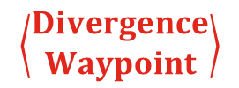
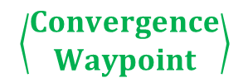
Overtake Maneuver - Trigger
$$\left\langle \begin{matrix}Convergence \\ Waypoint\end{matrix}\right\rangle$$
$$\left\langle \begin{matrix}Divergence \\ Waypoint\end{matrix}\right\rangle$$
The aircraft being overtaken has the right of the way

Slide 59
Overtake Maneuver - Resolution
$$\left\langle \begin{matrix}Convergence \\ Waypoint\end{matrix}\right\rangle$$
$$\left\langle \begin{matrix}Divergence \\ Waypoint\end{matrix}\right\rangle$$
Overtake is executed from right

Slide 60
Overtake Maneuver – Leave Condition
$$\left\langle \begin{matrix}Convergence \\ Waypoint\end{matrix}\right\rangle$$
$$\left\langle \begin{matrix}Divergence \\ Waypoint\end{matrix}\right\rangle$$
Overtake rule may apply only when well clear condition is guaranteed

Slide 61
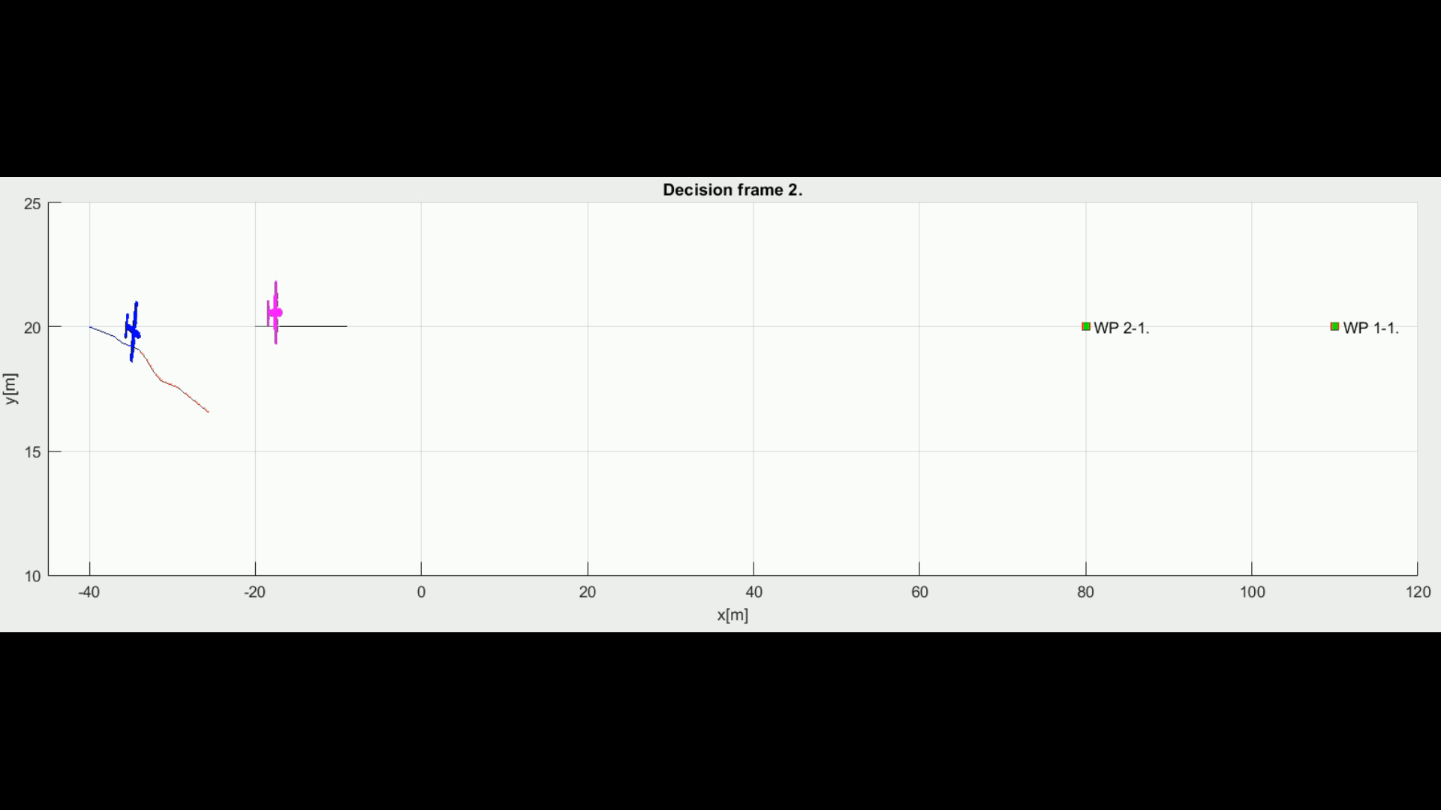
Example: Overtake Maneuver

Slide 62
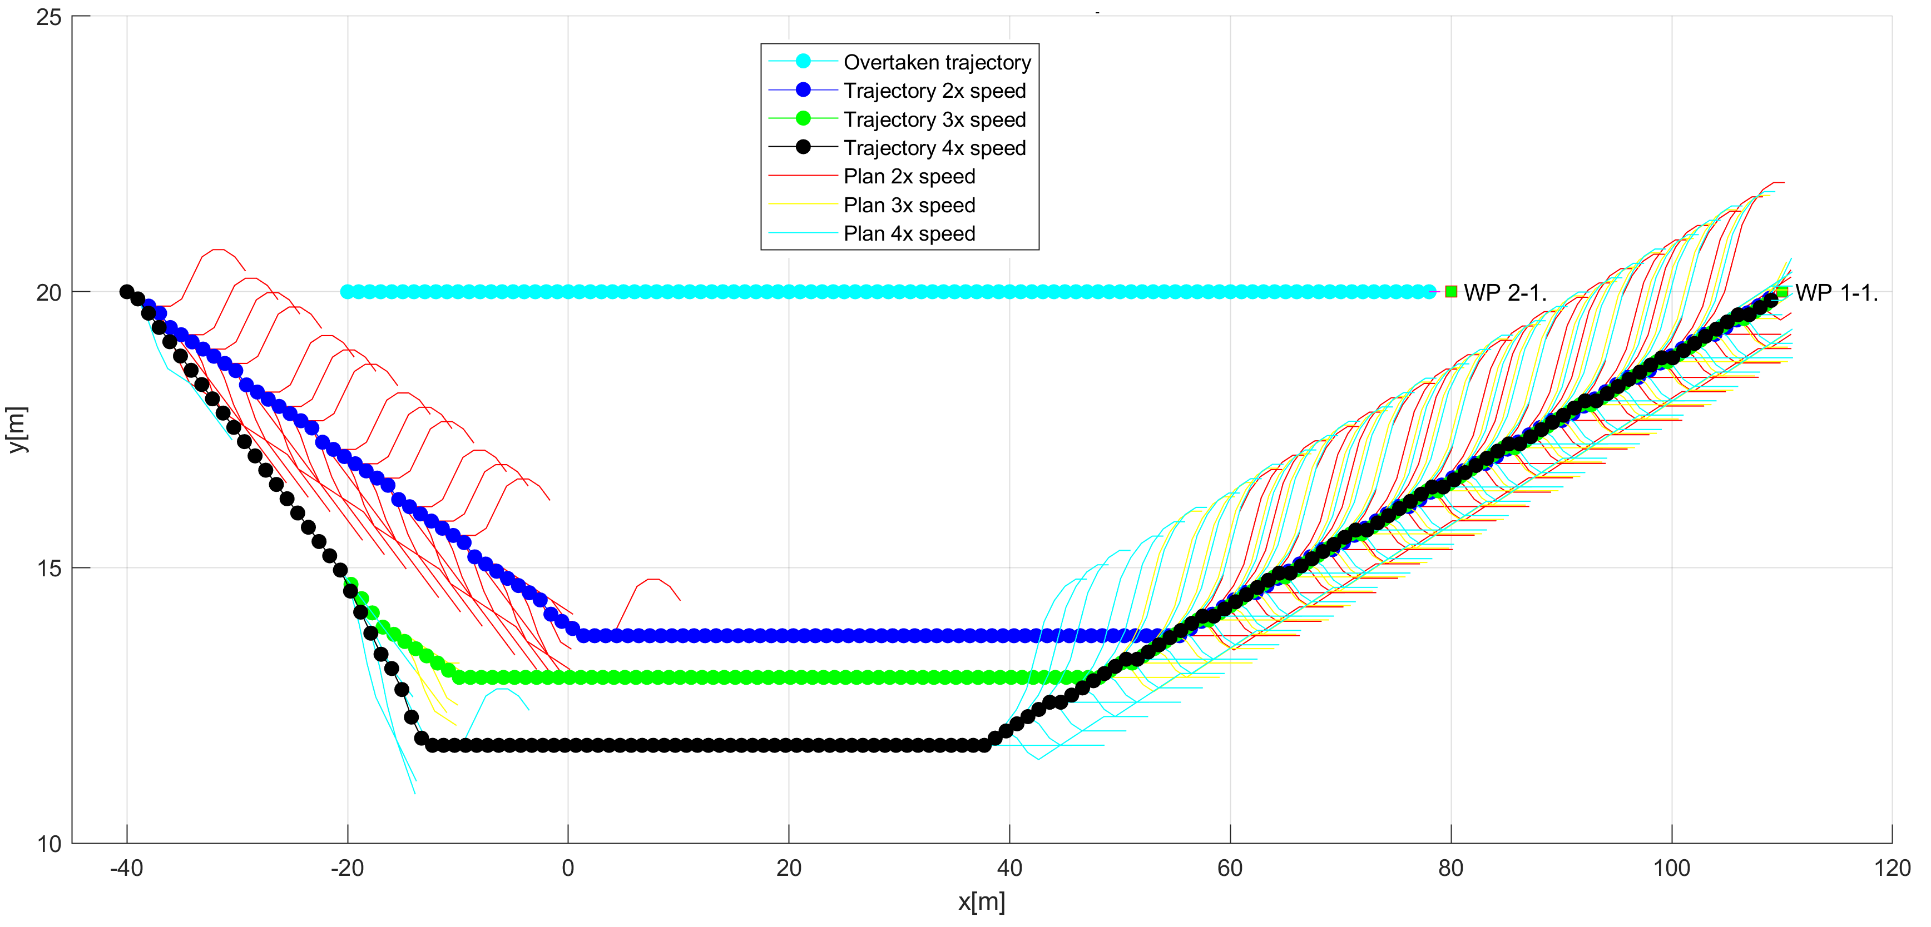
Different speed: Overtake Maneuver

Slide 63




Q&A Session

